Slide 1
How to Ruin a Presentation with POWERPOINT
C. Steven Bradford
University of Nebraska College of Law

Slide 2
That’s not true.

Slide 3
That’s not true, either.

Slide 4
None of this is true.

Slide 5
PowerPoint

Slide 6
PowerPoint?

Slide 7
Gettysburg Cemetery Dedication
Abraham Lincoln

Slide 8
Agenda
Met on battlefield (great)
Dedicate portion of field - fitting!
Unfinished work (great tasks)

Slide 9
Not on Agenda!
Dedicate
Consecrate
Hallow (in narrow sense)
Add or detract
Note or remember what we say

Slide 10
“PowerPoint doesn’t kill meetings. People kill meetings. But using Power-Point is like having a loaded AK-47 on the table: You can do very bad things with it.”
-Peter Norvig

Slide 12
His
Fault

Slide 14
BE ALL
YOU CAN BE

Slide 15
Rules are made to be broken
. . . by experts

Slide 16
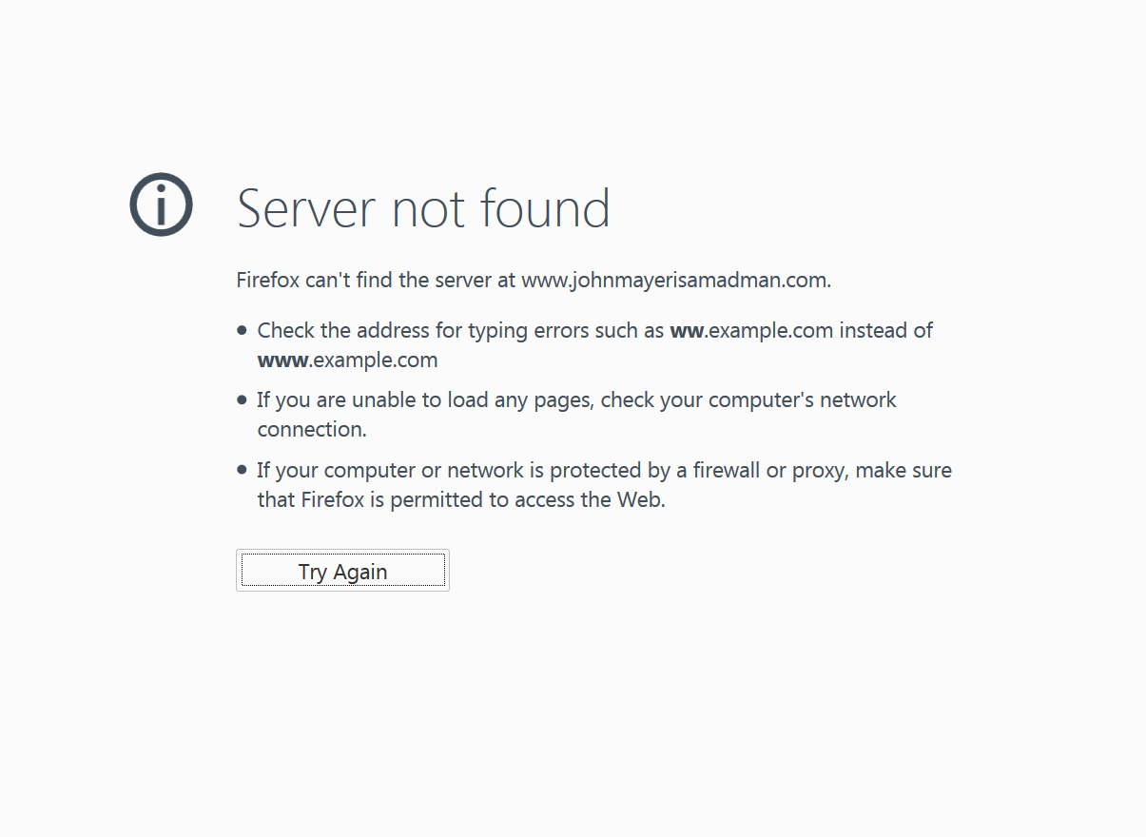
Screen clipping taken: 5/4/2015 9:45 AM

Slide 18
Bullet Points
Blah blah
Blah blah blah
Blah blah blah
Blah blah
Blah blah blah
Blah blah blah blah
Blah blah blah blah
Blah blah blah
Blah blah

Slide 19
Rocky Mountain National Park
Incredibly beautiful
Majestic, snow-capped mountains
Towering pines
Beautiful mountain lakes

Slide 20
Rocky Mountain National Park

Slide 22
Enhanced Learning
Words + Pictures

Slide 23
Enhanced Learning
Words + Pictures
Speech + Text + Pictures?

Slide 24
Bullet Points
Don’t bullet point everything you’re saying.
That’s why you’re there.
The words are your speech.
Use slides to supplement those words, not to repeat them.
In other words, don’t do what I’m doing on this slide.

Slide 25
“There are many true statements about complex topics that are too long to fit on a PowerPoint slide.”
-Edward Tufte

Slide 26
“And now for something completely different.”

Slide 27
Foot
Dweeb

Slide 28
Minimize Text

Slide 29
Bullet Points
One at a time

Slide 30
Bullet Points
One at a time
Emphasize as you build

Slide 31
Bullet Points
One at a time
Emphasize as you build

Slide 32
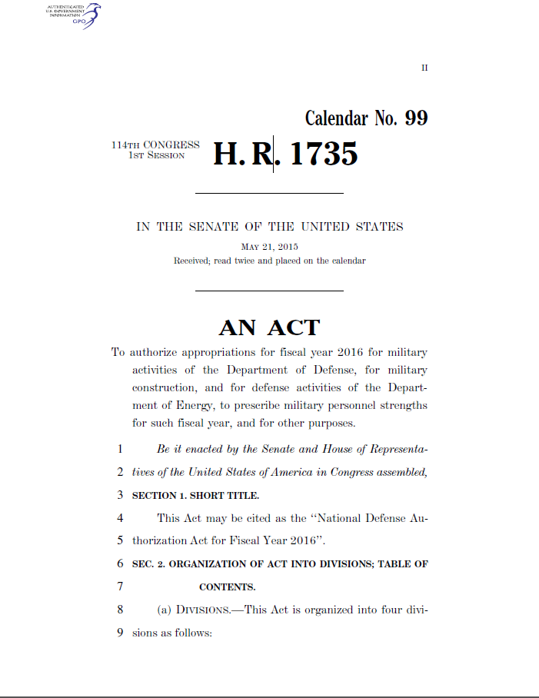
Law

Slide 33
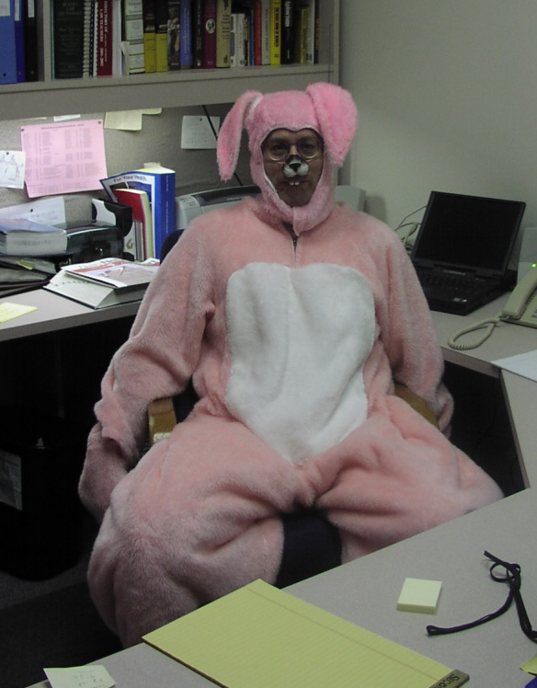
Law
Law
Professor

Slide 34
Law
Law
Professor

Slide 35
Size Matters
Size Matters

Slide 37
 | Harvard | Yale | Chicago | Stanford | Columbia | Texas | Cornell | Berkeley | NYU | Georgetown | Michigan
2014 | 13 | 19 | 54 | 74 | 87 | 13 | 66 | 20 | 63 | 18 | 45
2013 | 30 | 21 | 52 | 81 | 7 | 100 | 94 | 17 | 12 | 35 | 16
2012 | 48 | 91 | 100 | 72 | 83 | 71 | 3 | 5 | 3 | 40 | 58
2011 | 5 | 80 | 38 | 27 | 50 | 50 | 72 | 52 | 77 | 93 | 47
2010 | 19 | 13 | 61 | 37 | 44 | 17 | 11 | 65 | 56 | 43 | 62
2009 | 6 | 46 | 57 | 50 | 69 | 58 | 20 | 13 | 14 | 33 | 95
2008 | 100 | 66 | 92 | 89 | 29 | 87 | 99 | 72 | 77 | 74 | 21
2007 | 43 | 55 | 12 | 96 | 50 | 5 | 99 | 11 | 70 | 41 | 3
2006 | 99 | 97 | 11 | 37 | 5 | 13 | 61 | 44 | 15 | 31 | 62
2005 | 11 | 57 | 75 | 70 | 51 | 94 | 84 | 10 | 80 | 36 | 90
2004 | 80 | 21 | 96 | 59 | 27 | 88 | 84 | 80 | 53 | 7 | 6
2003 | 50 | 74 | 29 | 64 | 42 | 41 | 21 | 74 | 69 | 46 | 55
2002 | 9 | 10 | 19 | 27 | 36 | 31 | 51 | 10 | 96 | 54 | 49
2001 | 40 | 79 | 60 | 27 | 40 | 38 | 8 | 61 | 16 | 61 | 30
2000 | 10 | 58 | 72 | 8 | 35 | 4 | 47 | 57 | 10 | 31 | 4
1999 | 31 | 9 | 88 | 89 | 43 | 35 | 37 | 55 | 25 | 38 | 74
1998 | 61 | 22 | 36 | 51 | 30 | 3 | 39 | 65 | 46 | 60 | 25
1997 | 7 | 44 | 89 | 85 | 86 | 24 | 92 | 13 | 53 | 52 | 79
1996 | 73 | 55 | 73 | 68 | 64 | 20 | 97 | 96 | 27 | 45 | 20
1995 | 14 | 66 | 28 | 13 | 25 | 64 | 67 | 51 | 47 | 35 | 36
1994 | 44 | 86 | 2 | 96 | 37 | 93 | 25 | 33 | 5 | 72 | 77
1993 | 24 | 17 | 17 | 65 | 72 | 12 | 30 | 26 | 99 | 16 | 19
1992 | 33 | 82 | 55 | 91 | 77 | 41 | 14 | 10 | 87 | 53 | 76
1991 | 96 | 44 | 21 | 30 | 98 | 90 | 10 | 99 | 90 | 92 | 28
1990 | 60 | 22 | 56 | 25 | 53 | 30 | 26 | 22 | 31 | 80 | 85
1989 | 64 | 11 | 88 | 21 | 86 | 61 | 63 | 76 | 1 | 71 | 23
1988 | 31 | 30 | 14 | 65 | 31 | 77 | 68 | 18 | 99 | 62 | 92
1987 | 92 | 96 | 35 | 33 | 56 | 40 | 58 | 16 | 84 | 8 | 57
1986 | 97 | 81 | 14 | 34 | 16 | 87 | 26 | 50 | 72 | 57 | 98
1985 | 56 | 75 | 27 | 88 | 80 | 90 | 96 | 86 | 30 | 35 | 64
1984 | 29 | 69 | 67 | 10 | 38 | 40 | 39 | 50 | 80 | 100 | 16
1983 | 22 | 28 | 60 | 44 | 86 | 57 | 19 | 73 | 58 | 48 | 54
1982 | 64 | 90 | 20 | 12 | 56 | 4 | 24 | 67 | 73 | 5 | 38
1981 | 77 | 12 | 76 | 62 | 61 | 48 | 48 | 85 | 100 | 5 | 27

Slide 38
AVOID
Italics
Goofy Fonts

Slide 39
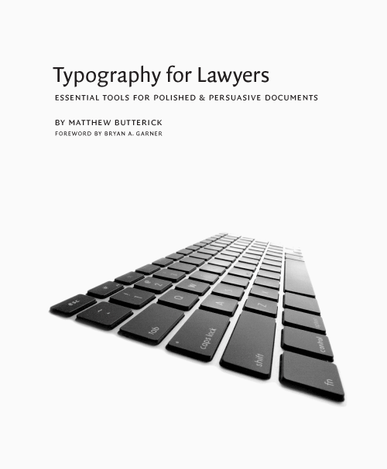

Slide 40
Don’t Change Fonts

Slide 41
Nice try. Do you really think I’m stupid enough to put my opinions of my dean on a publicly accessible slide?

Slide 42
Contrast
Is
Important

Slide 43
Avoid
Nauseating
Backgrounds

Slide 44
Well-Lit Room

Slide 45
Poorly-Lit Room

Slide 46
Black on White

Slide 48
This doesn’t work
This works

Slide 49
Not unless
you’re talking
about butterflies.

Slide 50
Distracting

Slide 51
make text and graphics easier to read.
Margins

Slide 54
Large Fonts + Margins
= NOT ENOUGH SPACE?

Slide 55
Rule 506. Exemption for limited offers and sales without regard to dollar amount of offering.
(a) Exemption. Offers and sales of securities by an issuer that satisfy the conditions in paragraph (b) or (c) of this section shall be deemed to be transactions not involving any public offering within the meaning of section 4(a)(2) of the Act.
(b) Conditions to be met in offerings subject to limitation on manner of offering—
(1) General conditions. To qualify for an exemption under this section, offers and sales must satisfy all the terms and conditions of §§230.501 and 230.502.
(2) Specific conditions—
(i) Limitation on number of purchasers. There are no more than or the issuer reasonably believes that there are no more than 35 purchasers of securities from the issuer in any offering under this section.
Note to paragraph (b)(2)(i): See §230.501(e) for the calculation of the number of purchasers and §230.502(a) for what may or may not constitute an offering under paragraph (b) of this section.
(ii) Nature of purchasers. Each purchaser who is not an accredited investor either alone or with his purchaser representative(s) has such knowledge and experience in financial and business matters that he is capable of evaluating the merits and risks of the prospective investment, or the issuer reasonably believes immediately prior to making any sale that such purchaser comes within this description.
(c) Conditions to be met in offerings not subject to limitation on manner of offering—
(1) General conditions. To qualify for exemption under this section, sales must satisfy all the terms and conditions of §§230.501 and 230.502(a) and (d).
(2) Specific conditions—
(i) Nature of purchasers. All purchasers of securities sold in any offering under paragraph (c) of this section are accredited investors.
(ii) Verification of accredited investor status. The issuer shall take reasonable steps to verify that purchasers of securities sold in any offering under paragraph (c) of this section are accredited investors. The issuer shall be deemed to take reasonable steps to verify if the issuer uses, at its option, one of the following non-exclusive and non-mandatory methods of verifying that a natural person who purchases securities in such offering is an accredited investor; provided, however, that the issuer does not have knowledge that such person is not an accredited investor:
(A) In regard to whether the purchaser is an accredited investor on the basis of income, reviewing any Internal Revenue Service form that reports the purchaser's income for the two most recent years (including, but not limited to, Form W-2, Form 1099, Schedule K-1 to Form 1065, and Form 1040) and obtaining a written representation from the purchaser that he or she has a reasonable expectation of reaching the income level necessary to qualify as an accredited investor during the current year;
(B) In regard to whether the purchaser is an accredited investor on the basis of net worth, reviewing one or more of the following types of documentation dated within the prior three months and obtaining a written representation from the purchaser that all liabilities necessary to make a determination of net worth have been disclosed:
(1) With respect to assets: Bank statements, brokerage statements and other statements of securities holdings, certificates of deposit, tax assessments, and appraisal reports issued by independent third parties; and
(2) With respect to liabilities: A consumer report from at least one of the nationwide consumer reporting agencies; or
(C) Obtaining a written confirmation from one of the following persons or entities that such person or entity has taken reasonable steps to verify that the purchaser is an accredited investor within the prior three months and has determined that such purchaser is an accredited investor:
(1) A registered broker-dealer;
(2) An investment adviser registered with the Securities and Exchange Commission;
(3) A licensed attorney who is in good standing under the laws of the jurisdictions in which he or she is admitted to practice law; or
(4) A certified public accountant who is duly registered and in good standing under the laws of the place of his or her residence or principal office.
(D) In regard to any person who purchased securities in an issuer's Rule 506(b) offering as an accredited investor prior to September 23, 2013 and continues to hold such securities, for the same issuer's Rule 506(c) offering, obtaining a certification by such person at the time of sale that he or she qualifies as an accredited investor.
Instructions to paragraph (c)(2)(ii)(A) through (D) of this section:
1. The issuer is not required to use any of these methods in verifying the accredited investor status of natural persons who are purchasers. These methods are examples of the types of non-exclusive and non-mandatory methods that satisfy the verification requirement in §230.506(c)(2)(ii).
2. In the case of a person who qualifies as an accredited investor based on joint income with that person's spouse, the issuer would be deemed to satisfy the verification requirement in §230.506(c)(2)(ii)(A) by reviewing copies of Internal Revenue Service forms that report income for the two most recent years in regard to, and obtaining written representations from, both the person and the spouse.
3. In the case of a person who qualifies as an accredited investor based on joint net worth with that person's spouse, the issuer would be deemed to satisfy the verification requirement in §230.506(c)(2)(ii)(B) by reviewing such documentation in regard to, and obtaining written representations from, both the person and the spouse.
(d) “Bad Actor” disqualification.
(1) No exemption under this section shall be available for a sale of securities if the issuer; any predecessor of the issuer; any affiliated issuer; any director, executive officer, other officer participating in the offering, general partner or managing member of the issuer; any beneficial owner of 20% or more of the issuer's outstanding voting equity securities, calculated on the basis of voting power; any promoter connected with the issuer in any capacity at the time of such sale; any investment manager of an issuer that is a pooled investment fund; any person that has been or will be paid (directly or indirectly) remuneration for solicitation of purchasers in connection with such sale of securities; any general partner or managing member of any such investment manager or solicitor; or any director, executive officer or other officer participating in the offering of any such investment manager or solicitor or general partner or managing member of such investment manager or solicitor:
(i) Has been convicted, within ten years before such sale (or five years, in the case of issuers, their predecessors and affiliated issuers), of any felony or misdemeanor:
(A) In connection with the purchase or sale of any security;
(B) Involving the making of any false filing with the Commission; or
(C) Arising out of the conduct of the business of an underwriter, broker, dealer, municipal securities dealer, investment adviser or paid solicitor of purchasers of securities;
(ii) Is subject to any order, judgment or decree of any court of competent jurisdiction, entered within five years before such sale, that, at the time of such sale, restrains or enjoins such person from engaging or continuing to engage in any conduct or practice:
(A) In connection with the purchase or sale of any security;
(B) Involving the making of any false filing with the Commission; or
(C) Arising out of the conduct of the business of an underwriter, broker, dealer, municipal securities dealer, investment adviser or paid solicitor of purchasers of securities;
(iii) Is subject to a final order of a state securities commission (or an agency or officer of a state performing like functions); a state authority that supervises or examines banks, savings associations, or credit unions; a state insurance commission (or an agency or officer of a state performing like functions); an appropriate federal banking agency; the U.S. Commodity Futures Trading Commission; or the National Credit Union Administration that:
(A) At the time of such sale, bars the person from:
(1) Association with an entity regulated by such commission, authority, agency, or officer;
(2) Engaging in the business of securities, insurance or banking; or
(3) Engaging in savings association or credit union activities; or
(B) Constitutes a final order based on a violation of any law or regulation that prohibits fraudulent, manipulative, or deceptive conduct entered within ten years before such sale;
(iv) Is subject to an order of the Commission entered pursuant to section 15(b) or 15B(c) of the Securities Exchange Act of 1934 (15 U.S.C. 78o(b) or 78o-4(c)) or section 203(e) or (f) of the Investment Advisers Act of 1940 (15 U.S.C. 80b-3(e) or (f)) that, at the time of such sale:
(A) Suspends or revokes such person's registration as a broker, dealer, municipal securities dealer or investment adviser;
(B) Places limitations on the activities, functions or operations of such person; or
(C) Bars such person from being associated with any entity or from participating in the offering of any penny stock;
(v) Is subject to any order of the Commission entered within five years before such sale that, at the time of such sale, orders the person to cease and desist from committing or causing a violation or future violation of:
(A) Any scienter-based anti-fraud provision of the federal securities laws, including without limitation section 17(a)(1) of the Securities Act of 1933 (15 U.S.C. 77q(a)(1)), section 10(b) of the Securities Exchange Act of 1934 (15 U.S.C. 78j(b)) and 17 CFR 240.10b-5, section 15(c)(1) of the Securities Exchange Act of 1934 (15 U.S.C. 78o(c)(1)) and section 206(1) of the Investment Advisers Act of 1940 (15 U.S.C. 80b-6(1)), or any other rule or regulation thereunder; or
(B) Section 5 of the Securities Act of 1933 (15 U.S.C. 77e).
(vi) Is suspended or expelled from membership in, or suspended or barred from association with a member of, a registered national securities exchange or a registered national or affiliated securities association for any act or omission to act constituting conduct inconsistent with just and equitable principles of trade;
(vii) Has filed (as a registrant or issuer), or was or was named as an underwriter in, any registration statement or Regulation A offering statement filed with the Commission that, within five years before such sale, was the subject of a refusal order, stop order, or order suspending the Regulation A exemption, or is, at the time of such sale, the subject of an investigation or proceeding to determine whether a stop order or suspension order should be issued; or
(viii) Is subject to a United States Postal Service false representation order entered within five years before such sale, or is, at the time of such sale, subject to a temporary restraining order or preliminary injunction with respect to conduct alleged by the United States Postal Service to constitute a scheme or device for obtaining money or property through the mail by means of false representations.
(2) Paragraph (d)(1) of this section shall not apply:
(i) With respect to any conviction, order, judgment, decree, suspension, expulsion or bar that occurred or was issued before September 23, 2013;
(ii) Upon a showing of good cause and without prejudice to any other action by the Commission, if the Commission determines that it is not necessary under the circumstances that an exemption be denied;
(iii) If, before the relevant sale, the court or regulatory authority that entered the relevant order, judgment or decree advises in writing (whether contained in the relevant judgment, order or decree or separately to the Commission or its staff) that disqualification under paragraph (d)(1) of this section should not arise as a consequence of such order, judgment or decree; or
(iv) If the issuer establishes that it did not know and, in the exercise of reasonable care, could not have known that a disqualification existed under paragraph (d)(1) of this section.
Instruction to paragraph (d)(2)(iv). An issuer will not be able to establish that it has exercised reasonable care unless it has made, in light of the circumstances, factual inquiry into whether any disqualifications exist. The nature and scope of the factual inquiry will vary based on the facts and circumstances concerning, among other things, the issuer and the other offering participants.
(3) For purposes of paragraph (d)(1) of this section, events relating to any affiliated issuer that occurred before the affiliation arose will be not considered disqualifying if the affiliated entity is not:
(i) In control of the issuer; or
(ii) Under common control with the issuer by a third party that was in control of the affiliated entity at the time of such events.
(e) Disclosure of prior “bad actor” events. The issuer shall furnish to each purchaser, a reasonable time prior to sale, a description in writing of any matters that would have triggered disqualification under paragraph (d)(1) of this section but occurred before September 23, 2013. The failure to furnish such information timely shall not prevent an issuer from relying on this section if the issuer establishes that it did not know and, in the exercise of reasonable care, could not have known of the existence of the undisclosed matter or matters.
Instruction to paragraph (e). An issuer will not be able to establish that it has exercised reasonable care unless it has made, in light of the circumstances, factual inquiry into whether any disqualifications exist. The nature and scope of the factual inquiry will vary based on the facts and circumstances concerning, among other things, the issuer and the other offering participants.

Slide 56
(b) Conditions to be met in offerings subject to limitation on manner of offering—
* * *
(2) Specific conditions—
(i) Limitation on number of purchasers. There are no more than or the issuer reasonably believes that there are no more than 35 purchasers of securities from the issuer in any offering under this section.

Slide 57
(b) Conditions to be met in offerings subject to limitation on manner of offering—
* * *
(2) Specific conditions—
(i) Limitation on number of purchasers. There are no more than or the issuer reasonably believes that there are no more than 35 purchasers of securities from the issuer in any offering under this section.

Slide 58
(b) Conditions to be met in offerings subject to limitation on manner of offering—
* * *
(2) Specific conditions—
(i) Limitation on number of purchasers. There are no more than or the issuer reasonably believes that there are no more than 35 purchasers of securities from the issuer in any offering under this section.

Slide 59
(b) Conditions to be met in offerings subject to limitation on manner of offering—
* * *
(2) Specific conditions—
(i) Limitation on number of purchasers. There are no more than or the issuer reasonably believes that there are no more than 35 purchasers of securities from the issuer in any offering under this section.

Slide 60
(b) Conditions to be met in offerings subject to limitation on manner of offering—
* * *
(2) Specific conditions—
(i) Limitation on number of purchasers. There are no more than or the issuer reasonably believes that there are no more than 35 purchasers of securities from the issuer in any offering under this section.

Slide 61
Rule 506. Exemption for limited offers and sales without regard to dollar amount of offering.
(a) Exemption. Offers and sales of securities by an issuer that satisfy the conditions in paragraph (b) or (c) of this section shall be deemed to be transactions not involving any public offering within the meaning of section 4(a)(2) of the Act.
(b) Conditions to be met in offerings subject to limitation on manner of offering—
(1) General conditions. To qualify for an exemption under this section, offers and sales must satisfy all the terms and conditions of §§230.501 and 230.502.
(2) Specific conditions—
(i) Limitation on number of purchasers. There are no more than or the issuer reasonably believes that there are no more than 35 purchasers of securities from the issuer in any offering under this section.
Note to paragraph (b)(2)(i): See §230.501(e) for the calculation of the number of purchasers and §230.502(a) for what may or may not constitute an offering under paragraph (b) of this section.
(ii) Nature of purchasers. Each purchaser who is not an accredited investor either alone or with his purchaser representative(s) has such knowledge and experience in financial and business matters that he is capable of evaluating the merits and risks of the prospective investment, or the issuer reasonably believes immediately prior to making any sale that such purchaser comes within this description.
(c) Conditions to be met in offerings not subject to limitation on manner of offering—
(1) General conditions. To qualify for exemption under this section, sales must satisfy all the terms and conditions of §§230.501 and 230.502(a) and (d).
(2) Specific conditions—
(i) Nature of purchasers. All purchasers of securities sold in any offering under paragraph (c) of this section are accredited investors.
(ii) Verification of accredited investor status. The issuer shall take reasonable steps to verify that purchasers of securities sold in any offering under paragraph (c) of this section are accredited investors. The issuer shall be deemed to take reasonable steps to verify if the issuer uses, at its option, one of the following non-exclusive and non-mandatory methods of verifying that a natural person who purchases securities in such offering is an accredited investor; provided, however, that the issuer does not have knowledge that such person is not an accredited investor:
(A) In regard to whether the purchaser is an accredited investor on the basis of income, reviewing any Internal Revenue Service form that reports the purchaser's income for the two most recent years (including, but not limited to, Form W-2, Form 1099, Schedule K-1 to Form 1065, and Form 1040) and obtaining a written representation from the purchaser that he or she has a reasonable expectation of reaching the income level necessary to qualify as an accredited investor during the current year;
(B) In regard to whether the purchaser is an accredited investor on the basis of net worth, reviewing one or more of the following types of documentation dated within the prior three months and obtaining a written representation from the purchaser that all liabilities necessary to make a determination of net worth have been disclosed:
(1) With respect to assets: Bank statements, brokerage statements and other statements of securities holdings, certificates of deposit, tax assessments, and appraisal reports issued by independent third parties; and
(2) With respect to liabilities: A consumer report from at least one of the nationwide consumer reporting agencies; or
(C) Obtaining a written confirmation from one of the following persons or entities that such person or entity has taken reasonable steps to verify that the purchaser is an accredited investor within the prior three months and has determined that such purchaser is an accredited investor:
(1) A registered broker-dealer;
(2) An investment adviser registered with the Securities and Exchange Commission;
(3) A licensed attorney who is in good standing under the laws of the jurisdictions in which he or she is admitted to practice law; or
(4) A certified public accountant who is duly registered and in good standing under the laws of the place of his or her residence or principal office.
(D) In regard to any person who purchased securities in an issuer's Rule 506(b) offering as an accredited investor prior to September 23, 2013 and continues to hold such securities, for the same issuer's Rule 506(c) offering, obtaining a certification by such person at the time of sale that he or she qualifies as an accredited investor.
Instructions to paragraph (c)(2)(ii)(A) through (D) of this section:
1. The issuer is not required to use any of these methods in verifying the accredited investor status of natural persons who are purchasers. These methods are examples of the types of non-exclusive and non-mandatory methods that satisfy the verification requirement in §230.506(c)(2)(ii).
2. In the case of a person who qualifies as an accredited investor based on joint income with that person's spouse, the issuer would be deemed to satisfy the verification requirement in §230.506(c)(2)(ii)(A) by reviewing copies of Internal Revenue Service forms that report income for the two most recent years in regard to, and obtaining written representations from, both the person and the spouse.
3. In the case of a person who qualifies as an accredited investor based on joint net worth with that person's spouse, the issuer would be deemed to satisfy the verification requirement in §230.506(c)(2)(ii)(B) by reviewing such documentation in regard to, and obtaining written representations from, both the person and the spouse.
(d) “Bad Actor” disqualification.
(1) No exemption under this section shall be available for a sale of securities if the issuer; any predecessor of the issuer; any affiliated issuer; any director, executive officer, other officer participating in the offering, general partner or managing member of the issuer; any beneficial owner of 20% or more of the issuer's outstanding voting equity securities, calculated on the basis of voting power; any promoter connected with the issuer in any capacity at the time of such sale; any investment manager of an issuer that is a pooled investment fund; any person that has been or will be paid (directly or indirectly) remuneration for solicitation of purchasers in connection with such sale of securities; any general partner or managing member of any such investment manager or solicitor; or any director, executive officer or other officer participating in the offering of any such investment manager or solicitor or general partner or managing member of such investment manager or solicitor:
(i) Has been convicted, within ten years before such sale (or five years, in the case of issuers, their predecessors and affiliated issuers), of any felony or misdemeanor:
(A) In connection with the purchase or sale of any security;
(B) Involving the making of any false filing with the Commission; or
(C) Arising out of the conduct of the business of an underwriter, broker, dealer, municipal securities dealer, investment adviser or paid solicitor of purchasers of securities;
(ii) Is subject to any order, judgment or decree of any court of competent jurisdiction, entered within five years before such sale, that, at the time of such sale, restrains or enjoins such person from engaging or continuing to engage in any conduct or practice:
(A) In connection with the purchase or sale of any security;
(B) Involving the making of any false filing with the Commission; or
(C) Arising out of the conduct of the business of an underwriter, broker, dealer, municipal securities dealer, investment adviser or paid solicitor of purchasers of securities;
(iii) Is subject to a final order of a state securities commission (or an agency or officer of a state performing like functions); a state authority that supervises or examines banks, savings associations, or credit unions; a state insurance commission (or an agency or officer of a state performing like functions); an appropriate federal banking agency; the U.S. Commodity Futures Trading Commission; or the National Credit Union Administration that:
(A) At the time of such sale, bars the person from:
(1) Association with an entity regulated by such commission, authority, agency, or officer;
(2) Engaging in the business of securities, insurance or banking; or
(3) Engaging in savings association or credit union activities; or
(B) Constitutes a final order based on a violation of any law or regulation that prohibits fraudulent, manipulative, or deceptive conduct entered within ten years before such sale;
(iv) Is subject to an order of the Commission entered pursuant to section 15(b) or 15B(c) of the Securities Exchange Act of 1934 (15 U.S.C. 78o(b) or 78o-4(c)) or section 203(e) or (f) of the Investment Advisers Act of 1940 (15 U.S.C. 80b-3(e) or (f)) that, at the time of such sale:
(A) Suspends or revokes such person's registration as a broker, dealer, municipal securities dealer or investment adviser;
(B) Places limitations on the activities, functions or operations of such person; or
(C) Bars such person from being associated with any entity or from participating in the offering of any penny stock;
(v) Is subject to any order of the Commission entered within five years before such sale that, at the time of such sale, orders the person to cease and desist from committing or causing a violation or future violation of:
(A) Any scienter-based anti-fraud provision of the federal securities laws, including without limitation section 17(a)(1) of the Securities Act of 1933 (15 U.S.C. 77q(a)(1)), section 10(b) of the Securities Exchange Act of 1934 (15 U.S.C. 78j(b)) and 17 CFR 240.10b-5, section 15(c)(1) of the Securities Exchange Act of 1934 (15 U.S.C. 78o(c)(1)) and section 206(1) of the Investment Advisers Act of 1940 (15 U.S.C. 80b-6(1)), or any other rule or regulation thereunder; or
(B) Section 5 of the Securities Act of 1933 (15 U.S.C. 77e).
(vi) Is suspended or expelled from membership in, or suspended or barred from association with a member of, a registered national securities exchange or a registered national or affiliated securities association for any act or omission to act constituting conduct inconsistent with just and equitable principles of trade;
(vii) Has filed (as a registrant or issuer), or was or was named as an underwriter in, any registration statement or Regulation A offering statement filed with the Commission that, within five years before such sale, was the subject of a refusal order, stop order, or order suspending the Regulation A exemption, or is, at the time of such sale, the subject of an investigation or proceeding to determine whether a stop order or suspension order should be issued; or
(viii) Is subject to a United States Postal Service false representation order entered within five years before such sale, or is, at the time of such sale, subject to a temporary restraining order or preliminary injunction with respect to conduct alleged by the United States Postal Service to constitute a scheme or device for obtaining money or property through the mail by means of false representations.
(2) Paragraph (d)(1) of this section shall not apply:
(i) With respect to any conviction, order, judgment, decree, suspension, expulsion or bar that occurred or was issued before September 23, 2013;
(ii) Upon a showing of good cause and without prejudice to any other action by the Commission, if the Commission determines that it is not necessary under the circumstances that an exemption be denied;
(iii) If, before the relevant sale, the court or regulatory authority that entered the relevant order, judgment or decree advises in writing (whether contained in the relevant judgment, order or decree or separately to the Commission or its staff) that disqualification under paragraph (d)(1) of this section should not arise as a consequence of such order, judgment or decree; or
(iv) If the issuer establishes that it did not know and, in the exercise of reasonable care, could not have known that a disqualification existed under paragraph (d)(1) of this section.
Instruction to paragraph (d)(2)(iv). An issuer will not be able to establish that it has exercised reasonable care unless it has made, in light of the circumstances, factual inquiry into whether any disqualifications exist. The nature and scope of the factual inquiry will vary based on the facts and circumstances concerning, among other things, the issuer and the other offering participants.
(3) For purposes of paragraph (d)(1) of this section, events relating to any affiliated issuer that occurred before the affiliation arose will be not considered disqualifying if the affiliated entity is not:
(i) In control of the issuer; or
(ii) Under common control with the issuer by a third party that was in control of the affiliated entity at the time of such events.
(e) Disclosure of prior “bad actor” events. The issuer shall furnish to each purchaser, a reasonable time prior to sale, a description in writing of any matters that would have triggered disqualification under paragraph (d)(1) of this section but occurred before September 23, 2013. The failure to furnish such information timely shall not prevent an issuer from relying on this section if the issuer establishes that it did not know and, in the exercise of reasonable care, could not have known of the existence of the undisclosed matter or matters.
Instruction to paragraph (e). An issuer will not be able to establish that it has exercised reasonable care unless it has made, in light of the circumstances, factual inquiry into whether any disqualifications exist. The nature and scope of the factual inquiry will vary based on the facts and circumstances concerning, among other things, the issuer and the other offering participants.

Slide 62
Speling
and
Grammer

Slide 65
Screen clipping taken: 5/4/2015 9:45 AM

Slide 66
Sounds

Slide 67
Transitions
THIS
OR THIS
OR EVEN THIS

Slide 68
Avoid Movement
of text
and images

Slide 69
Avoid Movement
of text
and images
from slide to slide

Slide 70
You

Slide 71
Practice

Slide 74
What about my laser?

Slide 75
What about my laser?

Slide 76
What about my laser?

Slide 77
What about my laser?

Slide 78
What about my laser?

Slide 79
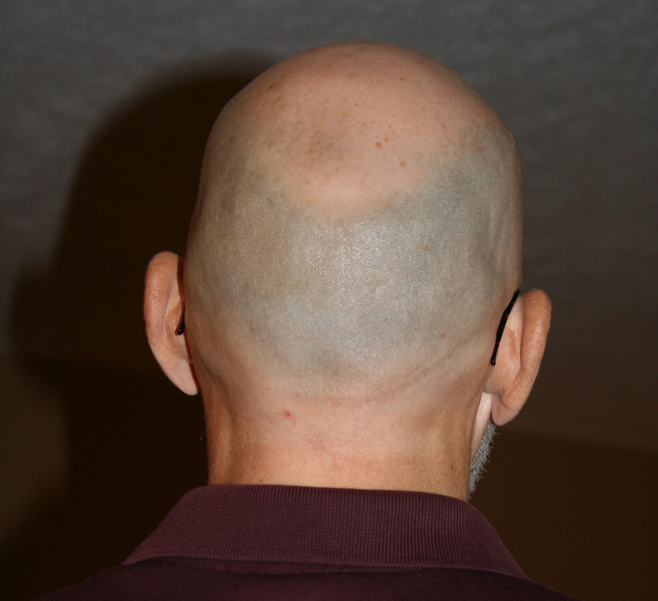

Slide 80
Timing

Slide 81
Omega registration statement filed
Pre-filing | Waiting | Post-Effective
5(a)
5(b)
5(c)
(Stop orders; refusal orders; investigations)

Slide 82
Section 5(b)(1) of the Securities Act
It shall be unlawful for any person, directly or indirectly—
(1) to make use of any means or instruments of transportation or communication in interstate commerce or of the mails to carry or transmit any prospectus relating to any security with respect to which a registration statement has been filed under this title, unless such prospectus meets the requirements of section 10;

Slide 83
Section 5(b)(1): “Carry or transmit any prospectus”
Section 2(a)(10): The term “prospectus” means any prospectus, notice, circular, advertisement, letter, or communication, written or by radio or television, which offers any security for sale or confirms the sale of any security; . . .

Slide 84
Section 5(b)(1): “Carry or transmit any prospectus”
Section 2(a)(10): The term “prospectus” means any prospectus, notice, circular, advertisement, letter, or communication, written or by radio or television, which offers any security for sale or confirms the sale of any security; . . .
Section 2(a)(3): The term “sale” or “sell” shall include every contract of sale or disposition of a security or interest in a security, for value. The term “offer to sell”, “offer for sale”, or “offer” shall include every attempt or offer to dispose of, or solicitation of an offer to buy, a security or interest in a security, for value. . . .

Slide 85
Section 5(b)(1): “Carry or transmit any prospectus”
Section 2(a)(10): The term “prospectus” means any prospectus, notice, circular, advertisement, letter, or communication, written or by radio or television, which offers any security for sale or confirms the sale of any security; . . .
Section 2(a)(9):
Written includes graphic communication
Rule 405
Defines “graphic communication”

Slide 86
Section 5(b)(1): “Carry or transmit any prospectus”
Section 2(a)(10): The term “prospectus” means any prospectus, notice, circular, advertisement, letter, or communication, written or by radio or television, which offers any security for sale or confirms the sale of any security; . . .
Rule 134
Not a prospectus

Slide 87
Section 5(b)(1) of the Securities Act
It shall be unlawful for any person, directly or indirectly—
(1) to make use of any means or instruments of transportation or communication in interstate commerce or of the mails to carry or transmit any prospectus relating to any security with respect to which a registration statement has been filed under this title, unless such prospectus meets the requirements of section 10;

Slide 88
Section 5(b)(1) of the Securities Act
It shall be unlawful for any person, directly or indirectly—
(1) to make use of any means or instruments of transportation or communication in interstate commerce or of the mails to carry or transmit any prospectus relating to any security with respect to which a registration statement has been filed under this title, unless such prospectus meets the requirements of section 10;
Section 10(a): Final prospectus (when effective)
Section 10(b): Other communications approved by the SEC
Rule 430-Preliminary Prospectus
Rule 431-Summary Prospectus
Rules 164 & 433-Free-Writing Prospectus

Slide 89
Pace

Slide 90
Moving cursors distract.

Slide 93
How to Ruin a Presentation with POWERPOINT
C. Steven Bradford
University of Nebraska College of Law
sbradford.unl@gmail.com

Slide 94
His
Fault

Slide 95
How to Ruin a Presentation with POWERPOINT
C. Steven Bradford
University of Nebraska College of Law
sbradford.unl@gmail.com

